Slide 1
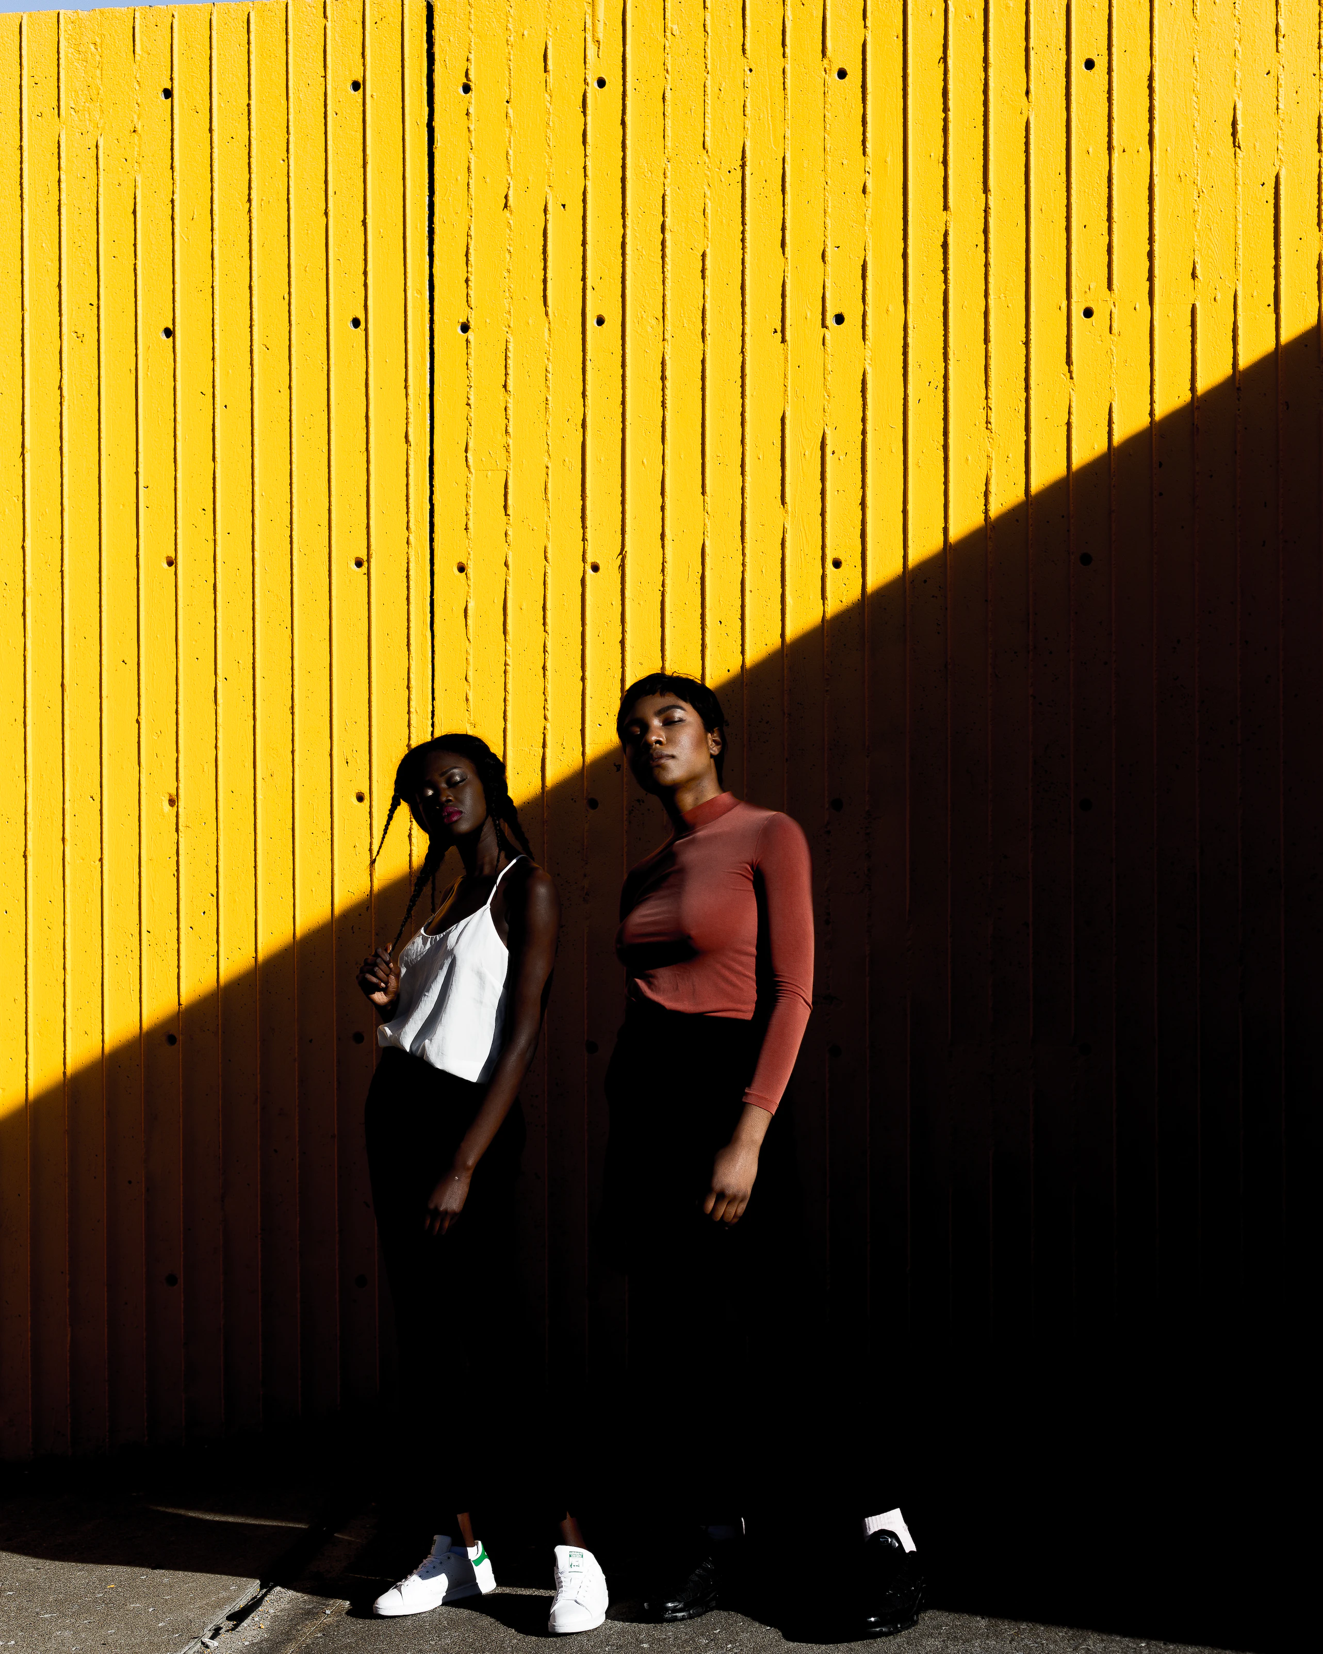
STICKZ Business Modeling for IT projects Conceptual data model
Group 4
Chiaolin Yang
Daniel Bassi Gloria Esionye Phoebe Malumi
Oladimeji, 2018. (Unsplash)

Slide 2
Overview
A multinational, wide demographic clothing company based in Alberta that specializes in offering high-quality,
casual wear for adult males and females.
Goal | Save our planet and look good in it Bringing extraordinary wears into our daily life, by choosing eco- friendly fabrics and materials.
Locations/Operations | Online shops and 6 physical retail stores located in Edmonton and Calgary.
Styles | Men, Women, casual wear, and seasonal collections. A strong design team across the world, bringing various in-season sights from the market.
Suppliers | Reliable, high-class products of our choices: India, Indonesia, Japan and Turkey.
Recycle project | From recycling old clothes from our loyal customers, we can prevent more waste and reward our planet savers with points and more!

Slide 3
Entities and Attributes
CUSTOMER: phone number, name, email, address, created_at, birthdate, age.
SALE: order_id, sales_id, timestamp(created_at)
PRODUCT: product_id, county_of_production, materials, quantity, price, etc.
EMPLOYEE: employee_id, name, phone number, start_date, salary.
ONLINE STORE: Website and App.
ONLINE ORDER: total value, order id, created at
PHYSICAL STORE: location, product_id, phone numbers.
ORDER: order_id, total_vaule, created_at, quantity
SHOPPING CART: cart_id, total_value, quantity
PAYMENT: payment_id, payment_type, amount
FEEDBACK: feedback_id, good, bad

Slide 4
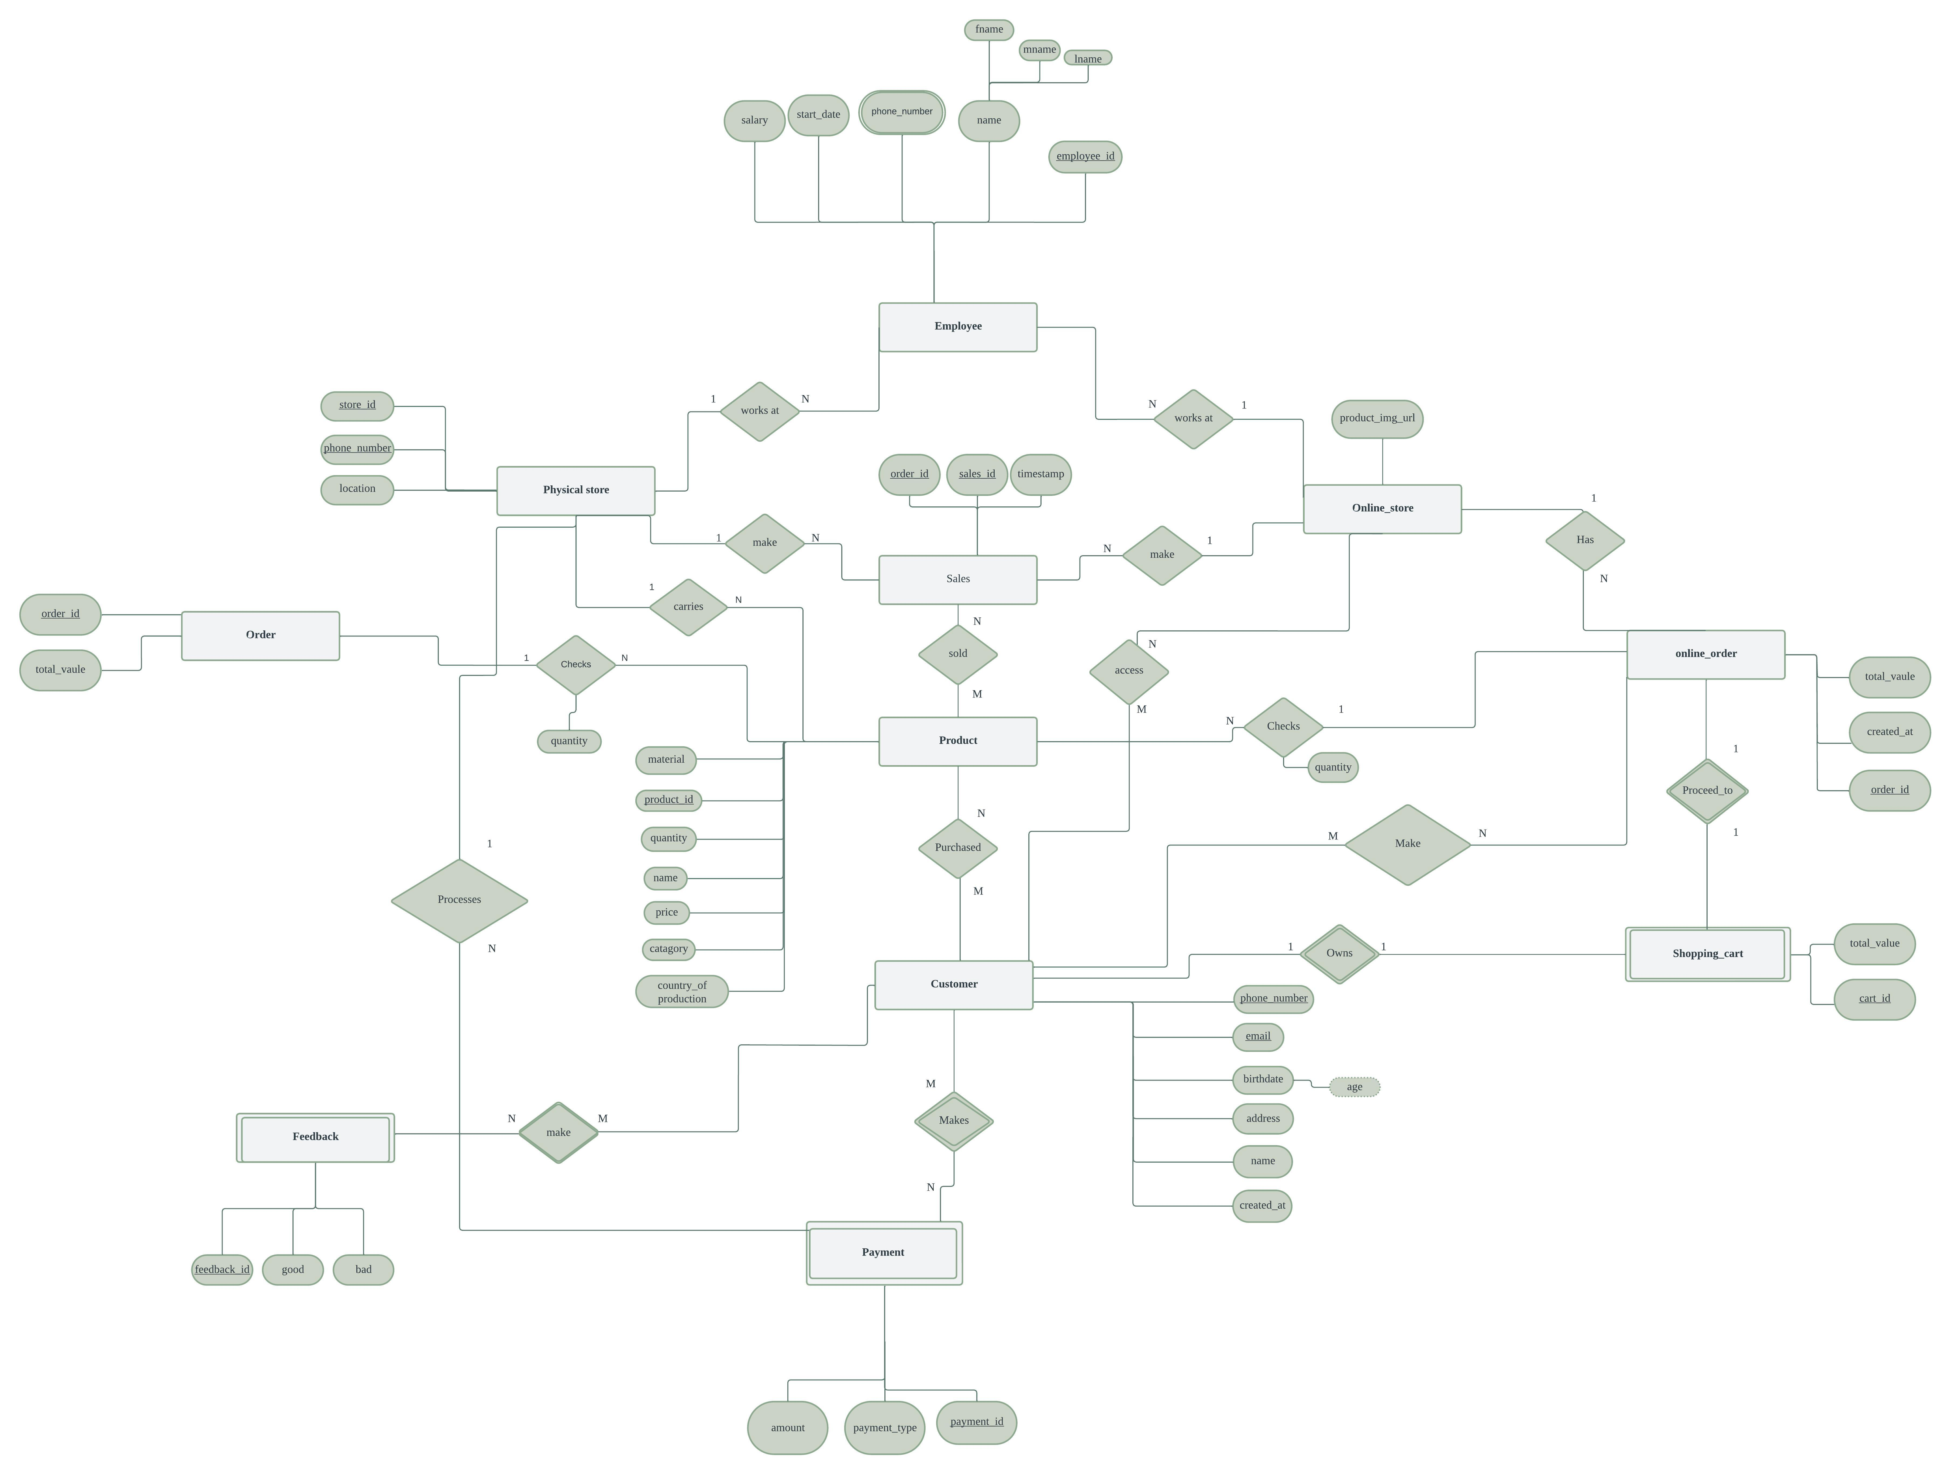
An ER diagram for STIKZ database schema
An ER diagram for STIKZ database schema

Slide 5
Questions?

Slide 6

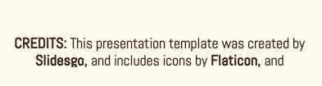
THANKS!

